Slide 1
Marketing Plan
MYB Detergent

Slide 2

A Brief about MYB Company
MYB Company is an emerging, registered and certified company.
MYB Company is a privately owned company.
MYB Company is located in Riyadh city, Saudi Arabia.
The company has a strong and determined management team.
MYB Company was initiated on March 15, 2019.
Notes:
MYB Company is an emerging, registered and certified company. It is a privately owned company located in Riyadh city, Saudi Arabia. The company has a strong and determined management team recruited based on professional qualifications. MYB Company was initiated on March 15, 2019. MYB Company founder was fascinated to utilize the evident business opportunity caused by lack of adequate baby powder detergent products, among others in the context of Riyadh city and the surrounding areas.

Slide 3

Mission Statement
To be a market leader by availing quality product and superior services to our customers and giving feedback for even higher standards for our products (Chernev, 2015).
To be a company that consistently focuses on its superior technological competences to provide different innovative solutions to meet our customer needs.
To be a company that makes an effort to attain the topmost standards in corporate ethics in serving society.
Notes:
MYB Company is a determined company, and its operations are bound to a couple of mission statements which acts as a concept map for its core operations to attain adorable market share. MYB Company is committed to being a market leader by availing quality product and superior services to our customers and giving feedback for even higher standards for our products (Chernev, 2015). It aims to become a company that consistently focuses on its superior technological competences to provide varied innovative solutions to meet our customer needs. Also, MYB’s mission is to become a company that makes an effort to attain the topmost standards in corporate ethics in serving society.

Slide 4
Vision
MYB Company aspires to be a world class organization and a global player in detergents and cleaning industry.
MYB Company strives for excellent services to its customers.
MYB Company aspires to attain increased flexibility and the ability to carry out an international business transaction.
Notes:
MYB Company tends to show an understanding of the implications of the current technological edge as a roadmap to its affiliated business activities. For that reason, MYB Company aspires to be a world class organization and a global player in detergents and cleaning industry. The company strives for excellent services to its customers. Also, aspires to attain increased flexibility and the ability to carry out an international business transaction.

Slide 5
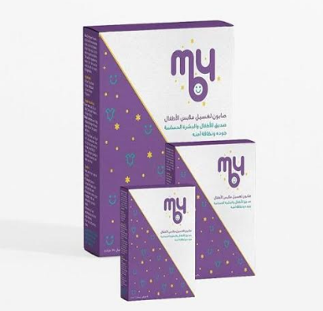
Product Description
MYB detergent
Notes:
MYB is formulated for a refreshing clean with the finest non-chemical materials and provided with a safe, soft, unique and dermatologically tested formula.

Slide 6

Targeted customers
Mothers who have children (aged 2 to 6 years).
Mothers who have babies (less than two years)
Notes:
MYB Company target customers are highly segmented. It strives to provide detergent and cleaning products to mothers who have babies who are less than two years of age. It also aims at meeting the cleaning needs of mommies whose children are of ages 2 to 6 years. However, other ages have also been found to make use of MYB to meet their needs and thus extending MYB’s customer segments.

Slide 7

Pricing strategy
These pricing strategies include:
  Cost and pricing strategy.
  Competitive pricing strategy
  Value-based pricing strategy
  Price skimming (McDONALD, 2016)
  Penetration strategy
.
Notes:
MYB Company has adopted effective marketing strategies to allow the company to chase its vision and mission. These pricing strategies include cost and pricing strategy where it calculates the cost and adds to a mark-up (McDONALD, 2016). Another strategy is a competitive pricing strategy, a strategy in which products are produced based on the competitor’s charge. Value-based pricing strategy is used to price products based on the quality of the product and the customer’s worth. Also, price skimming pricing strategy is used to assess market potential by pricing high and lowering it as the market develops. MYB Company marketing team also applies penetration pricing strategy in the most competitive markets by setting a low price to enter a competitive market and raising it later

Slide 8
SWOT analysis of MYB Company
Strengths Capital endowment Qualified and motivated employees Innovative production methods | Weaknesses No experience in detergent and cleaning industry No experience in distributing products No experience in marketing products Undefined way of giving feedback to the customer
Opportunities Large market The market is unfolding faster An increasing number of households Customer demand for innovative products | Threats Stiff competition Possibility of new entries Changes in consumer taste and preferences
Notes:
The above chart represent a brief summary of MYB Company SWOT analysis.

Slide 9
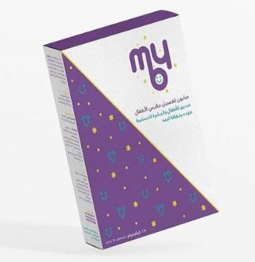
Continuation on
SWOT analysis of MYB Company…
Strengths
MYB Company strengths include:
Capital endowment (McDONALD, 2016).
Qualified and motivated employees
Innovative production methods and potential for new designs.
Notes:
MYB Company is growing at an alarming rate due to its well-defined strengths. The company is endowed with sufficient and constantly increasing capital, which allows it to offer quality products and services. Qualified and motivated employees help in attaining the firm’s goals promptly. The company has innovative production methods which magnify the potential for new designs (McDONALD, 2016).

Slide 10

Continuation on
SWOT analysis of MYB Company…
Weaknesses
No experience in detergent and cleaning industry
No experience in distribution to baby products
No experience in marketing fashionable products
Undefined way of giving feedback to the customer
Notes:
Although MYB Company has some adorable strengths, it has some core weaknesses to address. As such, MYB Company lacks adequate experience in detergent and cleaning industry since it is an emerging company. The firm has lacked expertise in distribution to baby products, and hence the majority of its distribution channels end up becoming a cost to the firm. The company has no experience in marketing fashionable products due to poor advertising practices. Undefined way of giving feedback to the customer and this limits customer care services.

Slide 11
Continuation on
SWOT analysis of MYB Company…
Opportunities
Large market
The market is unfolding faster than the firm’s current sales
An increasing number of households in Riyadh and the entire Saudi
Customer demand for fashionable baby products establishes a demand for innovative products
Threats
Stiff competition characterized by concentrated market shares
Possibility of new entries (Fahy & Jobber, 2015)
Changes in consumer taste and preferences in the future
Notes:
MYB’s core opportunities include large market which provides a wide array of customer segmentation. The market is growing faster than the firm’s current sales, and this creates a room for advancement in products and service provision (Fahy & Jobber, 2015). There is an increasing number of households in Riyadh and the entire Saudi. Ultimately, MYB’s customer demand for fashionable baby products has established a demand for innovative products.

Slide 12
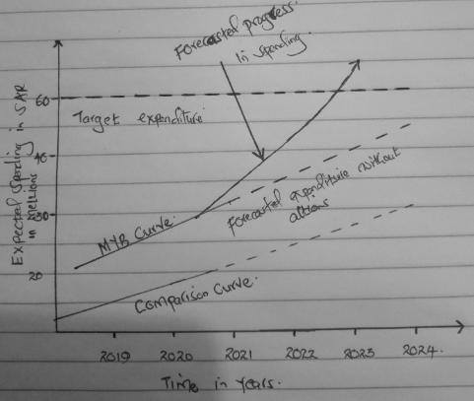
Expected Future Spending for MYB Company
Notes:
The above line graph represents the forecasted spending for MYB Company for the next five years. The company anticipates a positive trend in expenditure which will again mark the increase in service provision. The forecasted progress will also define the company’s ability to penetrate the entire market and hence accessin a greater market share.

Slide 13
Competitor analysis
Company | Market Share in percentage (%) | Advertising Million in SAR
MYB | 10 | 20 million SAR
Pigeon | 25 | 30 million SAR
Johnson | 35 | 32 million SAR
Other companies | 30 | Undefined
Notes:
The above chart provides a list of competitor companies in the detergent and cleaning industry of Saudi Arabia based market penetration and the estimated advertisement spending.

Slide 14
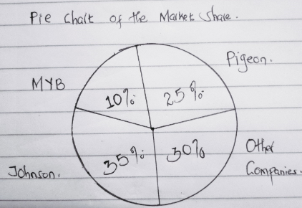
Competitor analysis
Notes:
The above pie chart provides a list of competitor companies in the detergent and cleaning industry of Saudi Arabia. The industry is quite competitive. Johnson takes 35% of the entire market. Pigeon takes 25% of the market share. MYB Company is at its market penetration and it has managed to attain only 10% of the entire market share. Other competitors occupy 30% of the entire market. This data shares an implication that our company stands a chance to do better by reducing competition and hence attaining a greater market share.

Slide 15
Continuation on competitor analysis…
Scope and nature of the detergent industry in Saudi
Saudi detergent market is valued to be 30 billion SR.
The industry has many competitive partakers.
MYB Company’s chief competitor is Pigeon Company.
Pigeon Detergent provides stiff competition to MYB detergent.
Notes:
Detergent and cleaning industry of Saudi Arabia is endowed with many competitive firms which are dedicated to providing adequate cleaning services. The detergent market is valued to be 30 billion SR. In this setting, Pigeon Company comes out as the most pronounced MYB’s competitor.

Slide 16
Pigeon’s pricing strategy
Competitive pricing strategy (Fahy & Jobber, 2015).
Values based pricing strategy
Penetration pricing strategy
Notes:
Pigeon Company is determined to redeem its operational vision and mission through acute dissemination of quality services. The company has adopted a competitive pricing strategy to lower the effects of competitors pricing (Fahy & Jobber, 2015). The firm believes that customers have a varied taste on values, and hence, value-based pricing strategy helps in meeting the tastes of customers differently. The company also seeks to grow in this competitive market and hence, penetration pricing strategy has been deemed effective as such, its products are lowly priced to allow penetration in the competitive market.

Slide 17
Pigeon Company’s SWOT
Strength
Innovative production methods
Experience in the distribution channel
Competitive capabilities
Weaknesses
Shortage of personnel
Lack of well-defined marketing products
Notes:
Pigeon Company is endowed with reputable, innovative production methods which enables it to produce a new product which meets the needs of its customers (Fahy & Jobber, 2015). The company has experience in distribution channels. It has good pricing strategies, and this boosts its competitive capabilities.
In regards to weaknesses, Pigeon company has been experiencing a shortage of personnel, and it lacks well-defined marketing products.

Slide 18
Continuation on Pigeon Company’s SWOT…
Opportunities
A growing market for increased sales
Increased customer demand for baby products
Threats
Strong competition (Chaudhary, Ghouse, & Durrah, 2018)
Ease of market entry.
Notes:
Pigeon Company has the opportunity to diversify its services to mothers and other consumers of baby powder detergents. Pigeon Company has also recorded a growing customer’s demand for baby powder products. However, the company has been challenged with strong competition in the entire industry (Chaudhary et al., 2018). Such an aspect has reduced the firm’s productivity and difficulties in accessing the increased market share. There is ease of market entry in the entire industry.

Slide 19

Target customers
Mothers who have babies of ages three years and bellow
Mothers with children aged 4 to 12 years
Notes:
Pigeon Company is committed to meet the needs of its customers. Its major focus group is mothers who have babies of ages two years and below.

Slide 20
Planning
Objectives
MYB Company marketing team has outlined quite attainable objectives, and these include:
To increase the firm’s market share by 3% in the first year
To attain sales over 7 million dollars in the first year.
Notes:
MYB Company core marketing objective include attaining increase the firm’s market share by 3% in the first year. The company aims at attaining sales, which are over 7 million dollars in the first year after launching the new MYB detergent.

Slide 21
Continuation on Planning…
Marketing strategies
The Chief Executive Officer will introduce a new product
Apply penetration pricing
Extensive advertising (Chaudhary et al., 2018)
Enhance expanded distribution.
Notes:
MYB Company’s marketing strategies are well outlined. As such, the company’s Chief Executive Officer will introduce a new MYB detergent while updating the entire team and the company about the company mission and vision. MYB Company will apply penetration pricing by pricing its products lower to seek acceptability and penetration in the market (Chaudhary et al., 2018). The company strategizes to offer extensive advertising services to ensure increased publicity of the product. Also, expanded distribution is underscored to increase market penetration.

Slide 22
Action plan
Product
  Three different designs of 110g, 500g, and 1500g packets of MYB will be provided within the first year.
Price
  The MYB detergent will be sold for a suggested retail price of 4 SR, 14 SR and 35 SR for 110g, 500g, and 1500g per packets respectively.
Place
  Our distribution will place in at least 75 per cent of locations in Saudi Arabia (Chernev, 2015).
Promotion
  A sales trainer will be hired to train the sales force in the new product.
  Four sales representatives will be hired to assist in the development of new distribution outlets.
Notes:
MYB’s action plan based on the marketing 4P’s. Regarding the product, the MYB detergent will be produced in 3 different designs of 110g, 500g, and 1500g to serve the customer with variety and hence meet their demands (Chernev, 2015). The products will be lowly priced with a suggested retail price of 4 SR, 14 SR and 35 SR for 110g-500g-1500g packets respectively. Regarding place, MYB Company distribution will place MYB detergents in at least 75 percent of locations in Saudi Arabia. Finally, MYB Company will complement promotion by hiring sales trainer will be hired to train the sales force in the new product. Four sales representatives will be hired to assist in the development of new distribution outlets and that extensive advertisement bloggers through will be put into consideration.

Slide 23
Conclusion
MYB Company stands a chance to shine in this competitive industry.
MYB Company may encounter increased market share.
The company may encounter challenging in tracking market tastes in MYB product.
Creativity and innovative designs must be embraced.
Notes:
MYB Company stands a chance to shine in this competitive industry. MYB Company may encounter increased market share. The company may encounter challenging in tracking market tastes in MYB product. Creativity and innovative designs must be embraced in Saudi Arabia and overseas.

Slide 24
References
Chaudhary, M., Ghouse, S. M., & Durrah, O. (2018). Young Arab consumers: an analysis of family buying process in Oman. Young Consumers, 19(1), 1-18.
Chernev, A. (2015). The marketing plan handbook. Cerebellum Press.
Fahy, J., & Jobber, D. (2015). Foundations of marketing.
McDONALD, M. A. L. C. O. L. M. (2016). Strategic marketing planning: theory and practice. In The marketing book (pp. 108-142). Routledge.

